Slide 1
Adaptive Code Developer’s Guide to Windows 10

Slide 2
Agenda
Compilation Conditionals
Platform Extension SDKs
Adaptive Code
Adaptive Code and API Versions
Declaring limitations on where your app can run

Slide 3
What are Adaptive Apps?
Windows apps adapt to different versions of the platform
Windows apps adapt to different types of devices
Windows apps adapt to different screen sizes
Adaptive UI handles different screens
Adaptive Code can "light up" your app to conditionally execute code only when running on specific device families and/or particular versions of platform/extension APIs
Conditionally take advantage of unique device capabilities
Use newer APIs while still supporting down-level clients

Slide 4
Compilation Conditionals

Slide 5
Windows 8.1 Universal: Shared code, two binaries
Windows Binary
Phone Binary
Notes:
With Universal Projects shared code resides in the shared project. Device specific code is contained in compiler directives which is compiled into separate executables per device family.

Slide 6
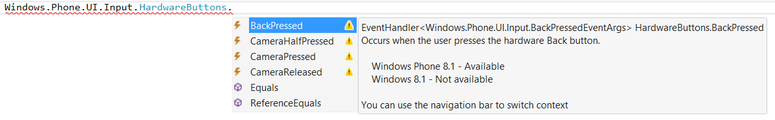
Not all APIs were available everywhere

Slide 7
Compilation directives
C# Syntax
#if WINDOWS_PHONE_APP Windows.Phone.UI.Input.HardwareButtons
.BackPressed += this.HardwareButtons_BackPressed; #endif
C++ Syntax
#if WINAPI_FAMILY==WINAPI_FAMILY_PHONE_APP _backPressedEventToken = HardwareButtons
::BackPressed += ref new EventHandler <BackPressedEventArgs^> (this,
&NavigationHelper::HardwareButton_BackPressed); #endif

Slide 8
Adaptive code in UWP: Introducing Platform Extension SDKs

Slide 9
Windows universal
Desktop PC
Mobile
Xbox
IoT
IoT headless
Surface Hub
Holographic
2 in 1
Phablet
Phone
Raspberry Pi
Surface Hub
HoloLens
Home Automation
Band
Xbox
Tablet

Slide 10
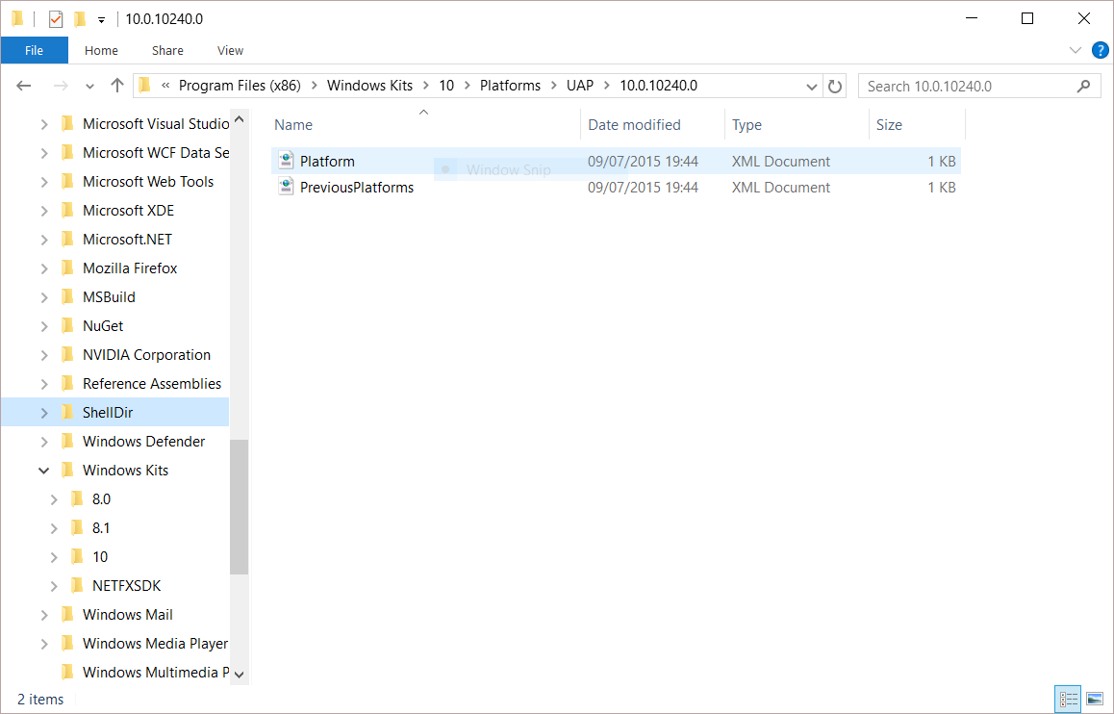
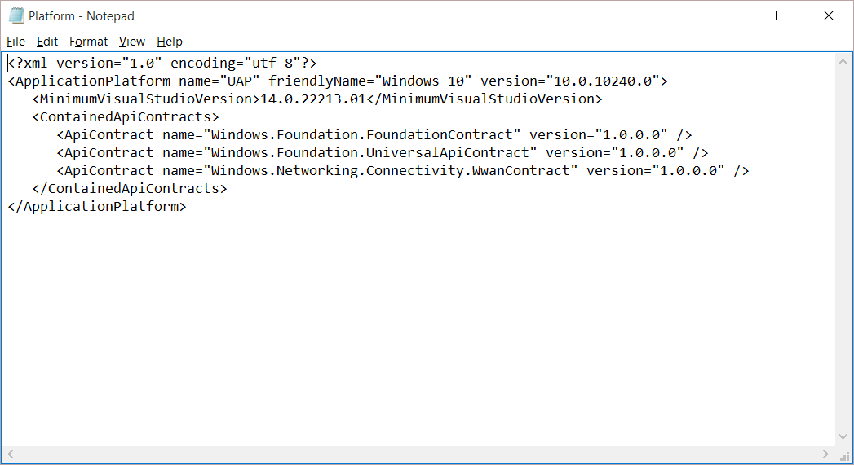
Universal Windows Platform
A single API surface
A guaranteed API surface
The same on all devices
Universal Windows Platform
Windows Core
Desktop
Device
Phone
Device
Xbox
Device

Slide 11
Many UWP apps will not need to use any device family-specific APIs, but for those that do, we have Platform extension SDKs

Slide 12
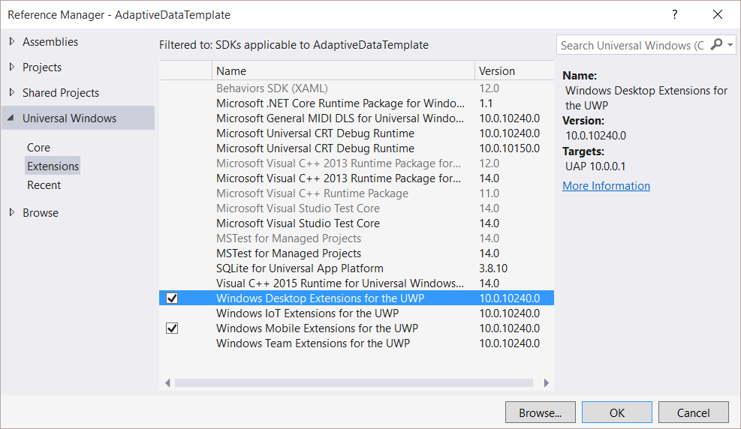
Platform extensions
Device-specific API
Family-specific capabilities
Compatible across devices
Unique update cadence
Windows App
Desktop
extension
Phone
extension
Xbox
extension
Universal Windows Platform
Windows Core
Desktop
Device
Phone
Device
Xbox
Device

Slide 13
Platform extensions don't invalidate binaries on other devices

Slide 14
UWP
UWP
UWP
UWP
Windows Core
Windows Core
Windows Core
Windows Core
Desktop
Mobile
Xbox
More…

Slide 15
Testing for capabilities
Windows.Foundation.Metadata.ApiInformation
IsApiContractPresent
IsEnumNamedValuePresent
IsEventPresent
IsMethodPresent
IsPropertyPresent
IsReadOnlyPropertyPresent
IsTypePresent
IsWriteablePropertyPresent
Notes:
Adaptive Code - You can now use new Windows.Foundation.Metadata.ApiInformation WinRT APIs to write adaptive code in your UAP project targeting different Windows devices. The class factory that returns an instance of the Windows.Foundation.Metadata.ApiInformation class must return an agile instance of the class. This allows clients to cache the instance and use it in any apartment. Additionally, the implementation of the ApiInformation class should be effectively stateless (or be able to transparently reacquire any needed state) to also allow the client to release an original instance, reacquire a new instance, and query without any side effects.
Determine whether an enum, struct, runtime class, or API Contract is defined on the current operating system.
Determine whether a specific method is defined on the current operating system.
Determine whether a specific arity of a method is defined on the current operating system.
Determine whether a specific event is defined on the current operating system.
Determine whether a property getter, setter, or both are defined on the current operating system.
Determine whether a named enum value is defined on the current operating system.
Determine whether a specific version of an API Contract is defined on the current operating system

Slide 16
Test capabilities at runtime
var api = "Windows.Phone.UI.Input.HardwareButtons";
if (Windows.Foundation.Metadata.ApiInformation.IsTypePresent(api))
{
Windows.Phone.UI.Input.HardwareButtons.CameraPressed += CameraButtonPressed;
}
Notes:
Or perhaps you could use the IsEventPresent to test for events such as:
CameraHalfPressed Occurs when the user presses the hardware camera button halfway.
CameraPressed Occurs when the user presses the hardware camera button.
CameraReleased Occurs when the user releases the hardware camera button.

Slide 17
The ApiInformation API tests for availability of a type or contract at runtime
Notes:
A developer can determine, at runtime, when a particular version of a specified API contract is supported.

Slide 18
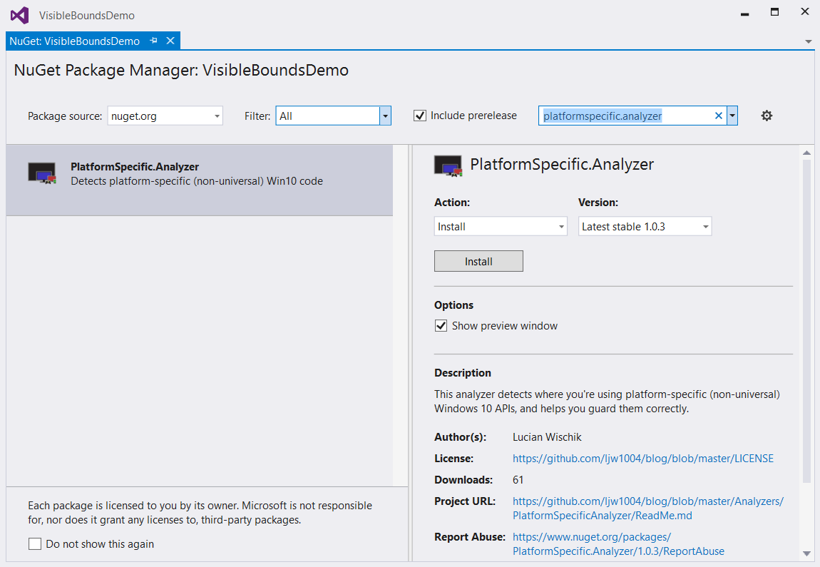
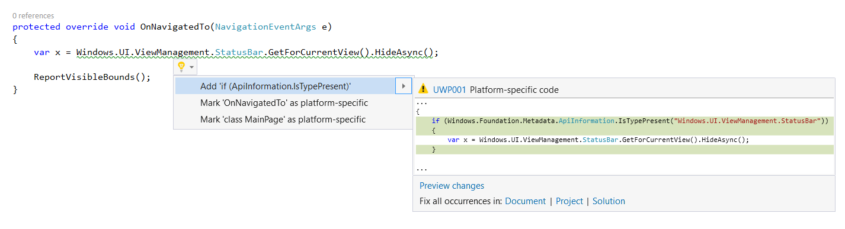
PlatformSpecific.Analyzer NuGet package

Slide 19
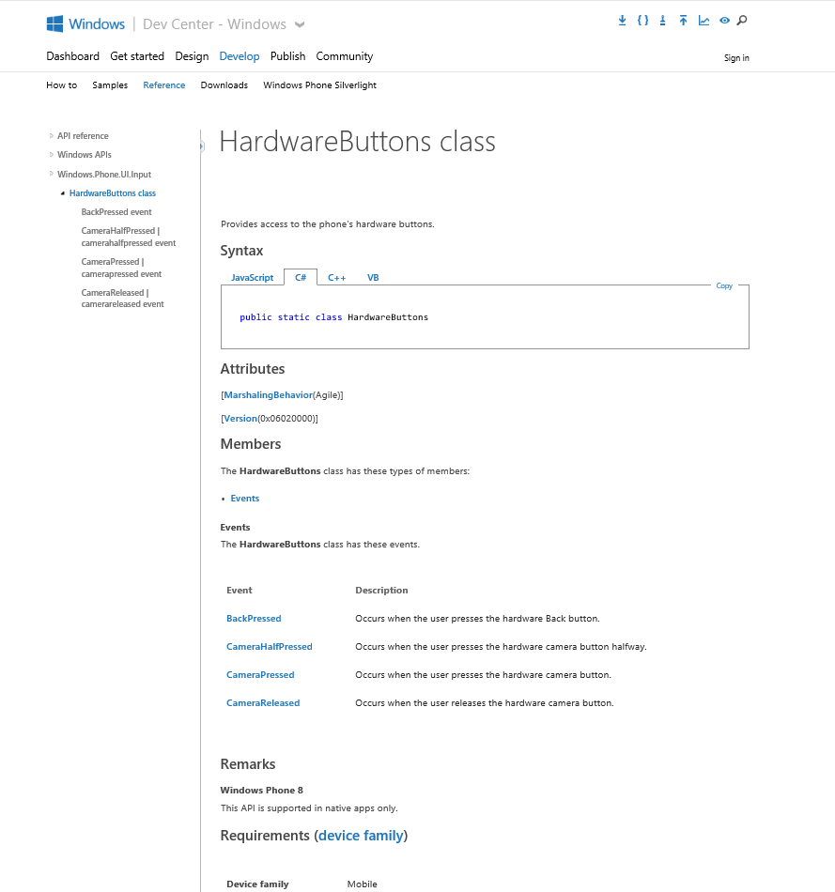
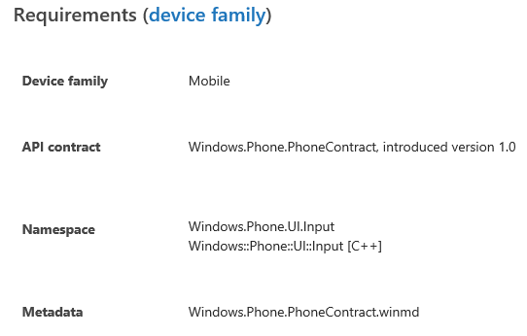
Identifying the Extension SDK
MSDN docs:

Slide 20
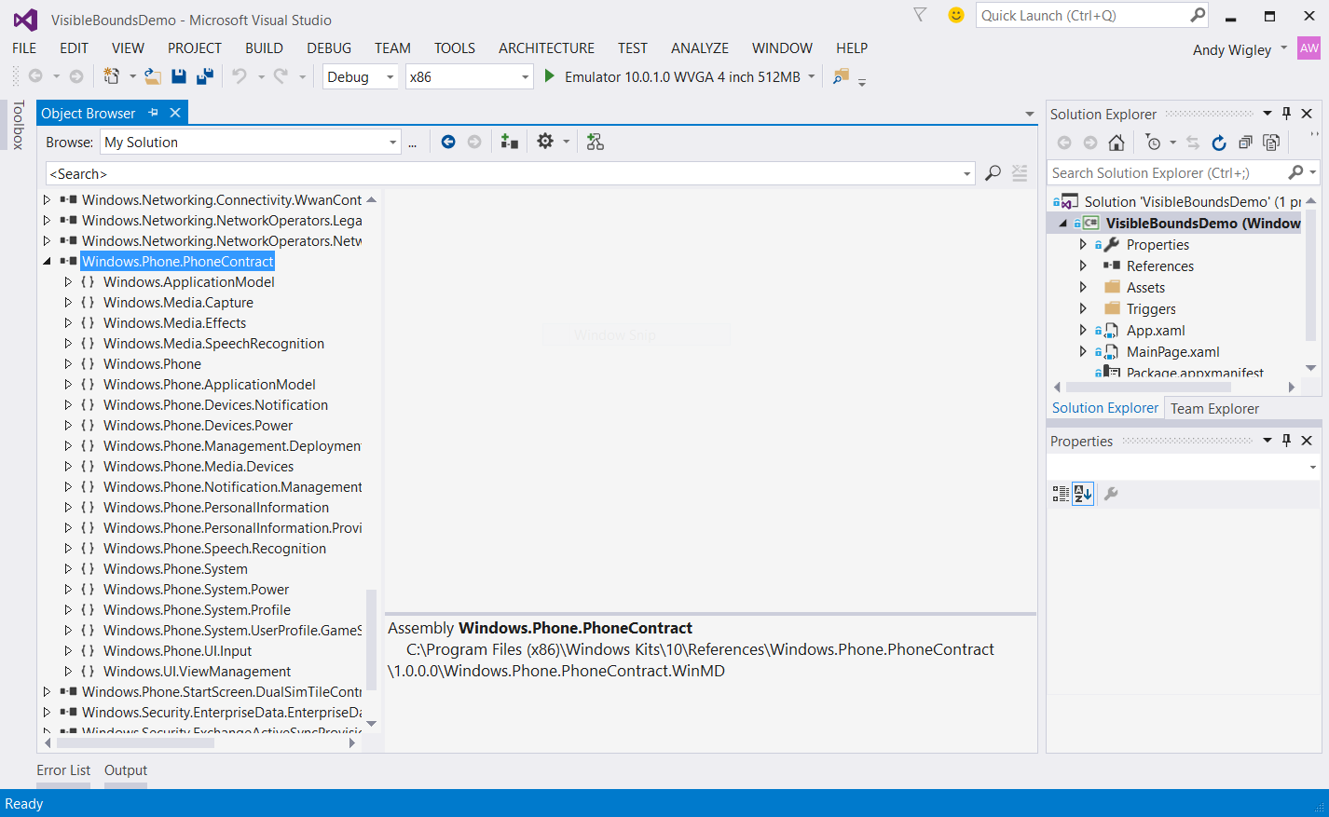
Exploring API Contracts

Slide 21
Demo: Api Information

Slide 22
Adaptive Code used to call specific API versions

Slide 23
Using Specific Versions of an API
Adaptive code techniques can also be used for handling different revisions of an API
You write your app against a UWP version, but ‘n’ months later, UWP v.Next ships to users machines
Applies to Extension SDKs and Packages as well – new versions may offer new functionality
You want to keep supporting customers who haven’t updated yet, but take advantage of up-level APIs for those who have

Slide 24
Gate use of up-level APIs
var contract = "Devices.Scanners.ScannerDeviceContract";
int majorVersionRequired = 3;
if (Windows.Foundation.Metadata.ApiInformation. IsApiContractPresent(contract, majorVersionRequired ))
{
// Call the API that is present in V3 and above
...
}
else
{
// Your original code supporting users who haven’t upgraded yet
...
}

Slide 25
What about Shared Projects?

Slide 26
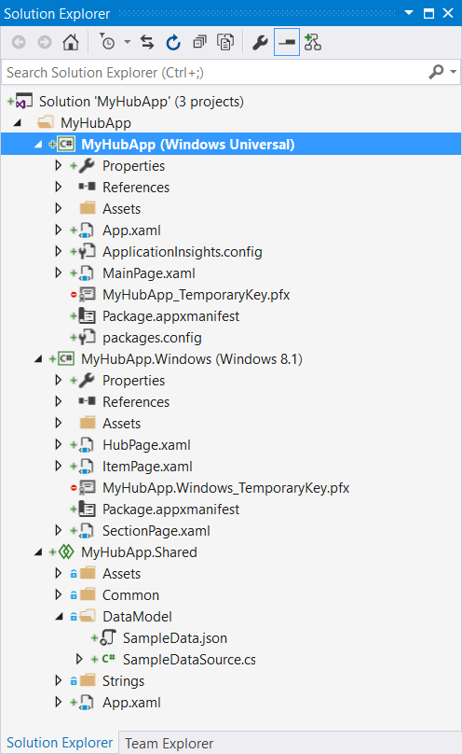
What about shared projects?
Shared Projects share code at the code level, pre-compilation
Share with Windows 8.1 projects, Xamarin projects, anything…
Still completely supported
#if Compilation directives used to conditionally include code by those projects referencing the Shared Project
WINDOWS_APP
WINDOWS_PHONE_APP
WINDOWS_UWP (new)
Notes:
If you want to keep support for windows 8.1 you can keep your shared project – and leverage the new compiler directive “WINDOWS_UAP” for Windows 10 specific functionality.
If you want to leverage full UAP targeting Windows 10, instead of compiler directives leverage the new ApiInformation.

Slide 27
Use Adaptive Code in Shared too!
#if WINDOWS_PHONE_APP
// Processing for Windows Phone 8.1 only Windows.Phone.UI.Input.HardwareButtons.CameraPressed += this.Camera_Pressed; #elif WINDOWS_UWP
// Processing for Windows UWP – Desktop AND Mobile if (Windows.Foundation.Metadata.ApiInformation .IsTypePresent("Windows.Phone.UI.Input.HardwareButtons";)) {
// But this is only for UWP AND Mobile Windows.Phone.UI.Input.HardwareButtons.CameraPressed += this.Camera_Pressed;
}
#endif

Slide 28
Declaring limitations on where your app can run

Slide 29
Declare Device Family Dependencies
Runs on all UWP device families:
<Dependencies>
<TargetDeviceFamily Name="Windows.Universal" minVersion="10.0.10240.0" maxVersionTested="10.5.0.0" />
</Dependencies>
Runs on all UWP, but limitations apply to Desktop:
<Dependencies>
<TargetDeviceFamily Name="Windows.Desktop" minVersion="10.2.0.0" maxVersionTested="10.4.0.0" />
<TargetDeviceFamily Name="Windows.Universal" minVersion="10.0.10240.0" maxVersionTested="10.5.0.0" />
</Dependencies>
Runs only on Mobile device family:
<Dependencies>
<TargetDeviceFamily Name="Windows.Mobile" minVersion="10.1.0.0" maxVersionTested="10.2.0.0" />
</Dependencies>
Notes:
App is explicitly saying that it can support behavior across a breaking change.

Slide 30
Package Dependency
<Dependencies>
<PackageDependency
Name="Microsoft.WinJS 1.0"
Publisher="CN=Microsoft Corporation, O=Microsoft Corporation, L=Redmond, S=Washington, C=US"
minVersion ="1.5.0.0" />
</Dependencies>

Slide 31
Review
Compiler Conditionals
Platform Extension SDKs
Adaptive Code
Adaptive Code and API Versions
Declaring limitations on where your app can run

